Slide 1
Environmental Risk Communications, Inc.
2023 Capabilities

Slide 2
ERCI Software and Consulting
Environmental liability recognition and measurement
  5,000 sites since 1994
  62 corporate and seaport client portfolios
  130+ CPA audits
Environmental counterparty risk tracking
Liability validation for auditing, MD&A, expert witness testimony, bankruptcy filings
Decision analysis
Database and Excel template development for liability tracking
Participation in ASTM Standard Development
  E2173, Standard Guide for Disclosure of Environmental Liabilities
  E2718, Standard Guide for Financial Disclosures Attributed to Climate Change
  E3123, Standard Guide for Recognition and Derecognition of Environmental Liabilities
  E3228, Standard Guide for Environmental Knowledge Management

Slide 3
Needs ERCI Meets
GAAP-Compliant Environmental Liability Forecasts (ASC 410, GASB 49 and 83, IAS 37)
      Data depth and rigor: relevant and faithful representations
      Watch list of future reserve increases
      Recognition of asset retirement obligations, remediation obligations, commitments, contingencies, guarantees
Fair Value Measurement (ASC 820, GASB 72, IFRS 13)
      Costing and pricing for MD&A, due diligence and purchase price allocation
      Identifying counterparties, assessing ability to pay, 24/7 tracking
      Identifying cost of strategy failure
Decision Support and Knowledge Management
      Custom software to store, sort and report site history, cost benchmarks, key assumptions, best practices, lessons learned
      Advanced decision support and scenario cost modeling

Slide 4
How Our Clients Benefit
GAAP-Compliant Liability Forecasts
  Reliable recognition, measurement, display and disclosure of environmental liabilities
  Third-party validation of reserve balances, future reserve increases
  MD&A: fair value measurement for buyers and sellers
  Measurement and containment counterparty risk
  Implementation of fair value measurement
Improved Capital Stewardship
  More reliable recognition and measurement of Obligations, Commitments, Obligations or Guarantees
  Strategic consistency: cost benchmarks, risks, pace to closure, remedial alternatives
  Better audit defense
  Better outcomes from MD&A, including purchase price allocation
  Prevention of counterparty default losses
  Decision quality: developing new options, accelerate / defer, pricing and choosing best path forward

Slide 5
ERCI Innovations
Developed RemedyDefender™ in Visual Basic with Crystal Ball®, used to manage 4,800+ unique environmental liabilities. 1994
Trained and supported 250+ corporate cleanup project managers and auditors. 1994-present
Developed first Monte Carlo model of a 2,000 site project portfolio. 1995
Shortest payback period for full Defender deployment: 3 hours. 1998
Developed one of the first due diligence models to support real-time fair value measurement of an environmental liability portfolio. 1999
Built and deployed Defender in 90 days to meet external auditor’s compliance deadline. 2000
Developed environmental counterparty tracking systems (ability to pay, probability of default, expected value of default, bankruptcy claim valuation). 2001
Built “watch list” for estimating and justifying future reserve increases. Derived “bow wave” equations for reserve increase recurrence. 2002
Co-developed site strategic plan template to quantify liabilities. 2002
Facilitated benchmarking groups in Superfund, midstream oil/gas, chemicals and automotive industries. 2004, 2008, 2011, 2014-present
Developed first real-time parametric model for sediment cleanup costs. 2007
Released first Markov Chain Monte Carlo (MCMC) environmental counterparty tracking system for PRP group managing 100+ years of NPL site work. 2013
Built catalog of 21 webinars on environmental liabilities, on our YouTube page. 2011-present
Developed back-testing system for comparing disclosed vs fair value of remediation reserves and asset retirement obligations. 2015

Slide 6













Audit Experience
Company | Division | Fortune 500 (sales) | Auditor | Audits
Chevron | Chevron Environmental Management Co. Chevron Pipe Line Co Chevron Canada, Ltd. Texaco Downstream Properties, Inc. | 3 |  | Annual, plus quarterly items
DCP Midstream | Corporate-wide Natural gas collection and pipelines | >500 |  | Annual
El Paso Corp | Now part of KinderMorgan, Inc. Diversified energy company | 315 |  | Annual, plus special items
FMC | Now three publicly-traded companies Diversified manufacturer | 467 |  | Annual
Hewlett-Packard | Corporate-wide Computer and microelectronics manufacturer | 17 |  | Annual or less (not material)
Northrop Grumman | Corporate-wide Aerospace and defense | 61 | and DCAA | Annual
Port of Seattle | Corporate-wide Regional airport and marine port authority | NA | and State Auditor | Annual
Tesoro Petroleum | Now part of Marathon Petroleum Oil refinery and marketer | 139 |  | Annual, plus special items
TRW Automotive | Now part of ZF Friedrichshafen Automotive parts | 201 |  | Annual
Univar | Corporate-wide Chemical processor and distributor | Private |  | Annual
Delphi | Now part of BorgWarner Inc. Automotive parts | Private |  | Annual, plus quarterly items

Slide 7
Five Types of Environmental Liabilities
Liabilities
Obligations
FASB: ASC 410
GASB: GASB 49 and 83
IASB: IAS 37
Guarantees
FASB: ASC 460
GASB: GASB 70
IASB: IAS 39
Commitments
FASB: ASC 440
GASB: Note disclosure
IASB: IAS 16
Contingencies
FASB: ASC 450
GASB: GASB 10
IASB: IAS 37
Env Remediation
Asset Retirement
Fifty companies agree with USEPA to pay for past response costs; by the time the settlement is finalized, only 40 are operating
Five companies sign consent order to study and clean up a site; one dissolves and orphans their share
Your company sells a division and promises to buy back a plant if contamination is found
A State requires a bond for 10 years of OM&M costs on a RCRA closure site; bond value must be updated annually
Oil well owner files Chapter 11 bankruptcy, doesn’t plug and abandon wells; reverts to you as previous owner

Slide 8
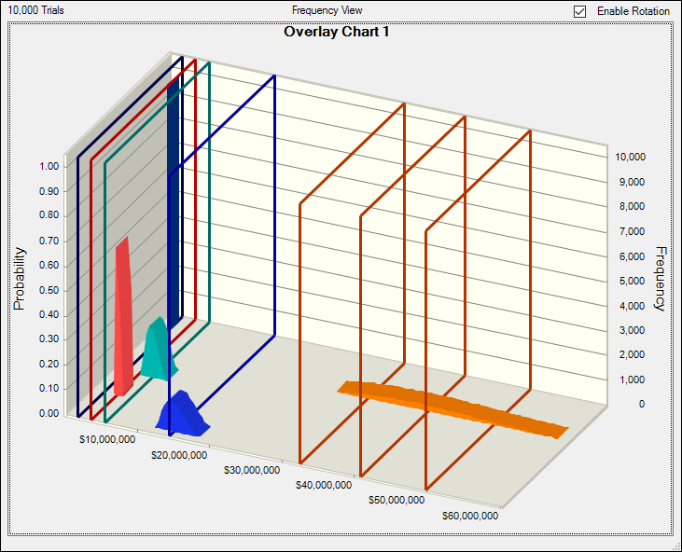
Five Types of Liabilities
Takeaway: remedial and asset retirement obligations are commonly disclosed; commitments, contingencies and guarantees are rarely disclosed
GUARANTEES
$1,960,000
COMMITMENTS
$3,800,000
CONTINGENCIES
$5,600,000
ASSET RETIREMENT
$14,400,000
REMEDIAL OBLIGATIONS
$40,800,000

Slide 9
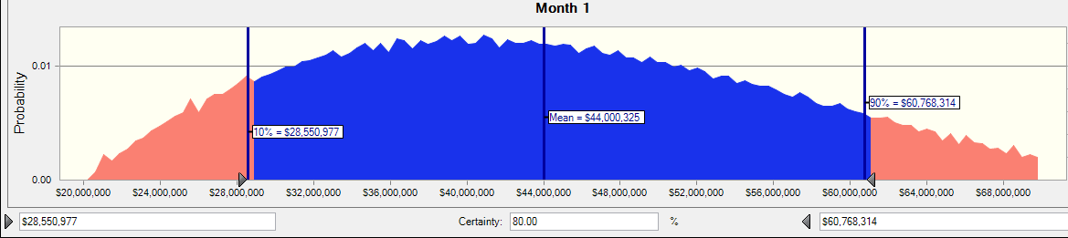
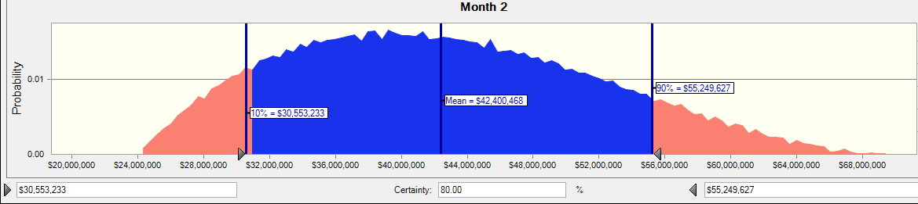
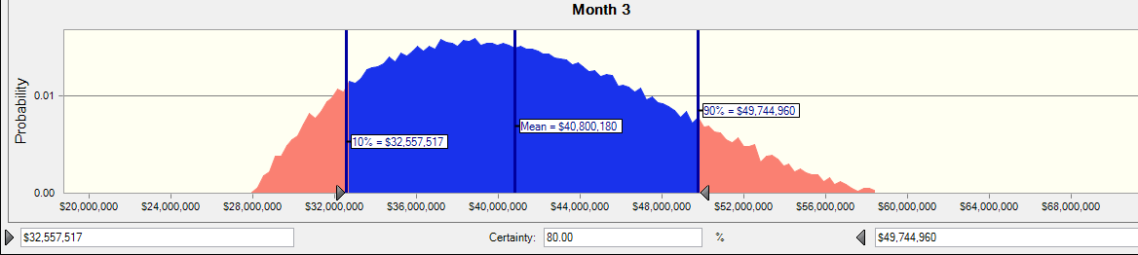
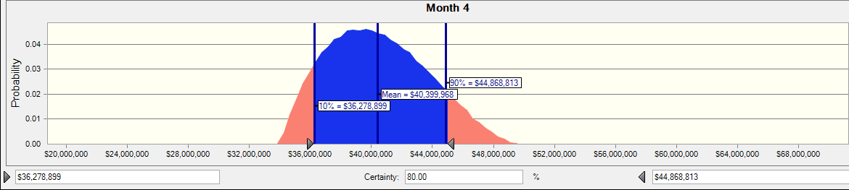
Portfolio Report: Reporting the Ranges
Month 1
Month 2
Month 3
Month 4
Takeaway: ranges narrow as definitive information is collected and more decisions are made

Slide 10
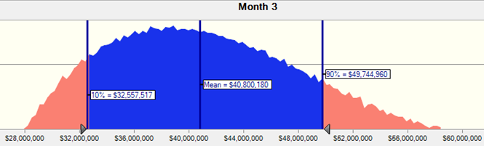
Tornado Diagram - Liability Portfolio
ERCI’s experience is that a few portfolio-wide assumptions and a few large sites create most of the uncertainty (risk) in the portfolio.
This display visually ranks the assumptions by their importance to the portfolio value.
<<<PORTFOLIO VALUE>>>>>>>>>>>
Discount rate: 7%
Discount rate: 3%
Inflation: 1.5%
Inflation: 4.5 %
Haz landfill unit rate: $85/ton
Haz landfill unit rate: $150/ton
Site 18: on-site closure by 2027
Site 18: off-site disposal by 2025
Non-Haz landfill: $40/ton
Non-Haz landfill: $80/ton
Site 4-A: no soil remediation
Site 4-A: both soil and groundwater remediation
Expected Value
= $40.8 M

Slide 11

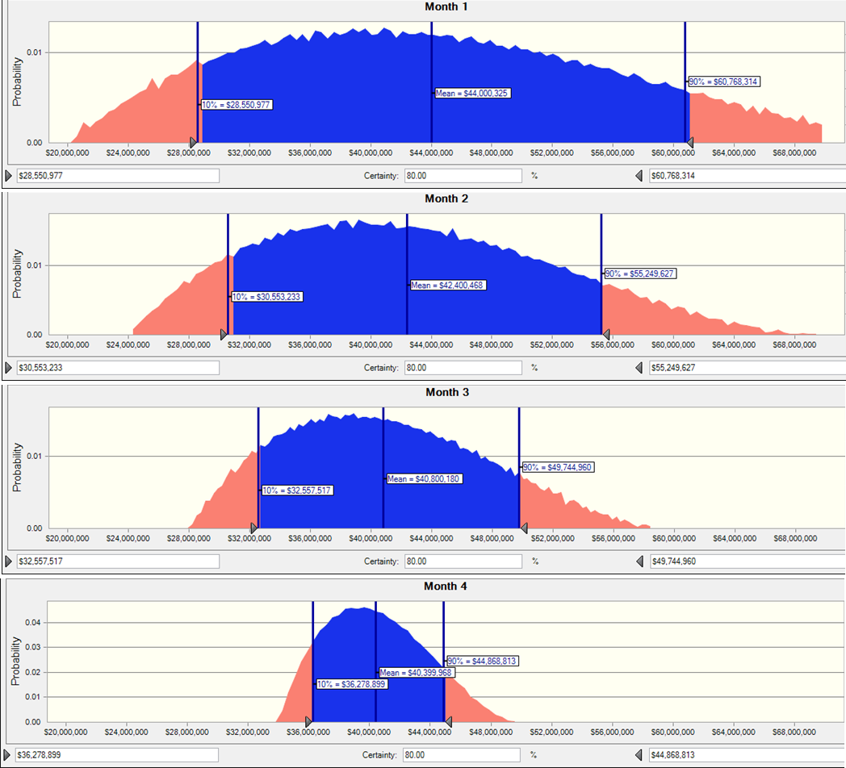
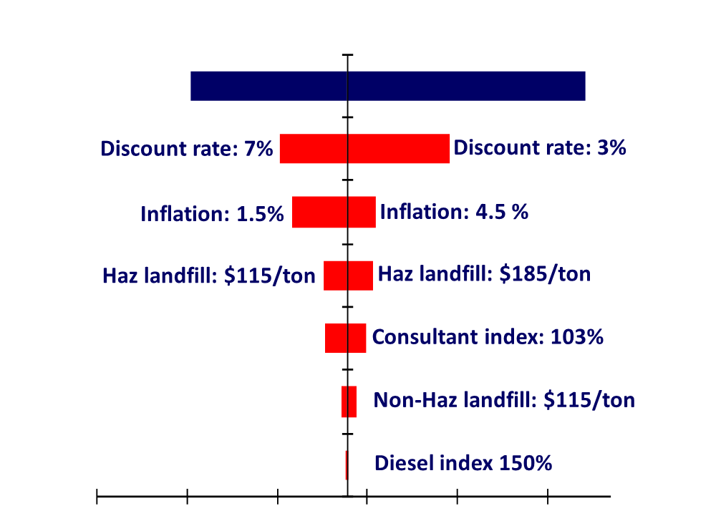
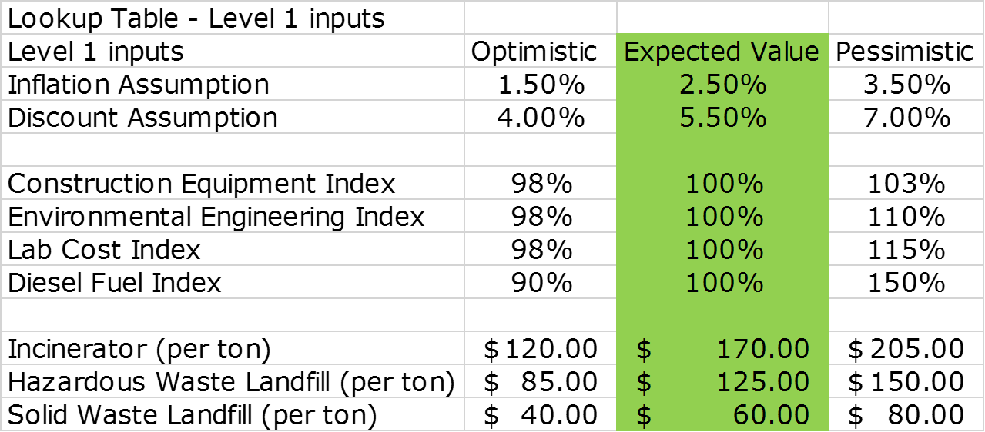
Data Pyramid
Portfolio
Reports
Portfolio-wide Assumptions
Component Sites & Liabilities
ERL
ERL
ARO Asset Retirement Obligations
ERL Environmental Remediation Liabilities
COM Commitment
CON Contingency
GUA Guarantee
COM
ERL
ARO
ERL
ARO
COM
ERL
ARO
ERL
ARO
COM
ARO
ERL
ERL
ARO
ERL
ERL
ERL
ERL
ARO
ERL
ERL
ERL
CON
ERL
ARO
ERL
ERL
CON
ERL
ARO
ERL
ERL
CON
GUA
COM
CON
ERL
ARO
ERL
ERL
CON
COM
GUA
GUA
GUA
COM
CON
ERL
ARO
ERL
ERL
CON
COM
GUA
GUA
GUA
COM
CON
ERL
ARO
ERL
ERL
CON
COM
GUA

Slide 12
Verifiable Counterparty Assumptions
…what you have to know for your liability to be zero
Types of Counterparties | Liability Types > [GAAP Citation >] | Asset Retirement [ASC410-20, GASB18] | Env Remediation [410-30, GASB49] | Commitments [ASC 440] | Contingencies [ASC 450, GASB 10] | Guarantees [ASC 460, GASB70]
 | Successor owners and tenants | They will fully fund the assessment and demolition work, some day, or sell to someone who will perform. | They will study and remediate any future spills. They will not sell to a future defaulter. | They will indemnify and defend for any future spills. | They will indemnify and defend for any and all future claims. | They will provide financial assurance for LT monitoring.
 | Predecessor owners and tenants | They will promptly pay for their share of future ARO costs, some day. | They will respond to you or regulators investigating past spills, and participate in good-faith negotiations to allocate costs. | They will keep contractual promise to buy back a contaminated property. | They will answer a CERCLA 104(e) info request and join a PRP group to fund study and remediation costs. | They will provide financial assurance for LT monitoring.
 | Joint venture partners | They will promptly pay for their share of future ARO costs, some day. | They will promptly pay for their share of future study and remediation costs, some day. | They will document their changes in successors and assigns perpetually. | They will share the stranded costs of other defaulting PRPs, and redo a failed cleanup . | They will document their changes in successors and assigns perpetually.
 | PRPs on active CERCLA sites | NA | They will honor the terms of a PRP agreement perpetually. | They will honor the terms of a PRP agreement perpetually. | They will meet all cash calls perpetually. | They will share the cost of EPA financial assurance, if any
 | Adjacent property owners sharing pathways/receptors | NA | Contamination from their property will not reach your property. They will pay their share of future study and remediation costs. | NA | They will promptly pay for their share of future study and remediation costs, some day. | NA
 | Landfills in use today | NA | NA | They will honor the commitment to indemnify and defend for any future releases. | They will close operating landfills at their cost, including the one(s) with your waste. | Their guarantees will continuously be accepted by State and Fed regulators.
 | Insurers of owners, tenants, or vendors | They will promptly pay your eligible claims. | They will promptly pay your eligible claims. | They will promptly pay your eligible claims. | They will promptly pay your eligible claims. | They will promptly pay your eligible claims.
typically reserved today
Takeaway: polluters are self-insurers of public policy (“polluter pays”); enforce or forgo your recoveries

Slide 13
ERCI Views on Counterparty Risk Trends
 | 2017 | 2022
Lower average scores √ Downward trend is continuing “diminishing”
No longer stable √ Larger companies used to be stable; now all are in flux “wobbly”
Moving across a wider range √ Larger swings are normal √ Unusual directions/velocity “erratic”
Moving more often √ More frequent swings are now normal “volatile”
b
b
b
c
a
c
a
a
c
b
b
b
b
b
b
b
b
b
b
b
b
b
?
b
?
Takeaways: expect material issues from counterparties more frequently; respond to need for shorter reaction time with proactive monitoring

Slide 14
Takeaways on Counterparty Risk
Riskier economy, more dynamic than ever
  Top quartile of creditworthiness tends to be stable
  Bottom 10% holds 90% of the risk
  Privately-held companies hold undisclosed risks
Growing commitments to/from counterparties
  Creates off balance sheet risks
  Growing risks in asset retirement, sustainability, ESG
Time creates counterparty risk
  “No look” agreements on properties
  Temporary lack of regulatory enforcement resources
  PRPs maintaining low profile, or dissolving
Nonperformance risks – if you let them happen
  Any PRP group can lose any PRP…at any time
  25% of a typical PRP group is bankrupt in 17 years
  50% have modified corporate structure in nine years

Slide 15
  How to Manage Enviro. Counterparty Risk
Single site
  Quantify the exposures (PRPs at risk, timeline to prevention)
  Document the baseline costs for auditing, benchmarking
  Set triggers for actions (observe, insure, liquidate, litigate)
Portfolio of sites
  Confirm reserve values and budgets
  Confirm “watch list” of future reserves
  Answers to key questions
    “What is the value of indemnifications to us from others? How are they booked?”
    “How does this compare to the indemnifications we made to others?
    “What is the sum of all counterparty risks we have with company XYZ over the next ten years?”
    “How does that sum compare with the credit limit in place at our operating business units for company XYZ?”
    “Are any indemnifications with XYZ worth cross-cancellation?”

Slide 16
  ERCI’s Tool for Counterparty Risk Valuation
Measurement basis
Reporting values >

